Slide 2
about us
Join stock company
Slovak owners
On the market since 1993
154 employees
Annual turnover 10 000 000 € per year 2017
Worldwide export

Slide 3
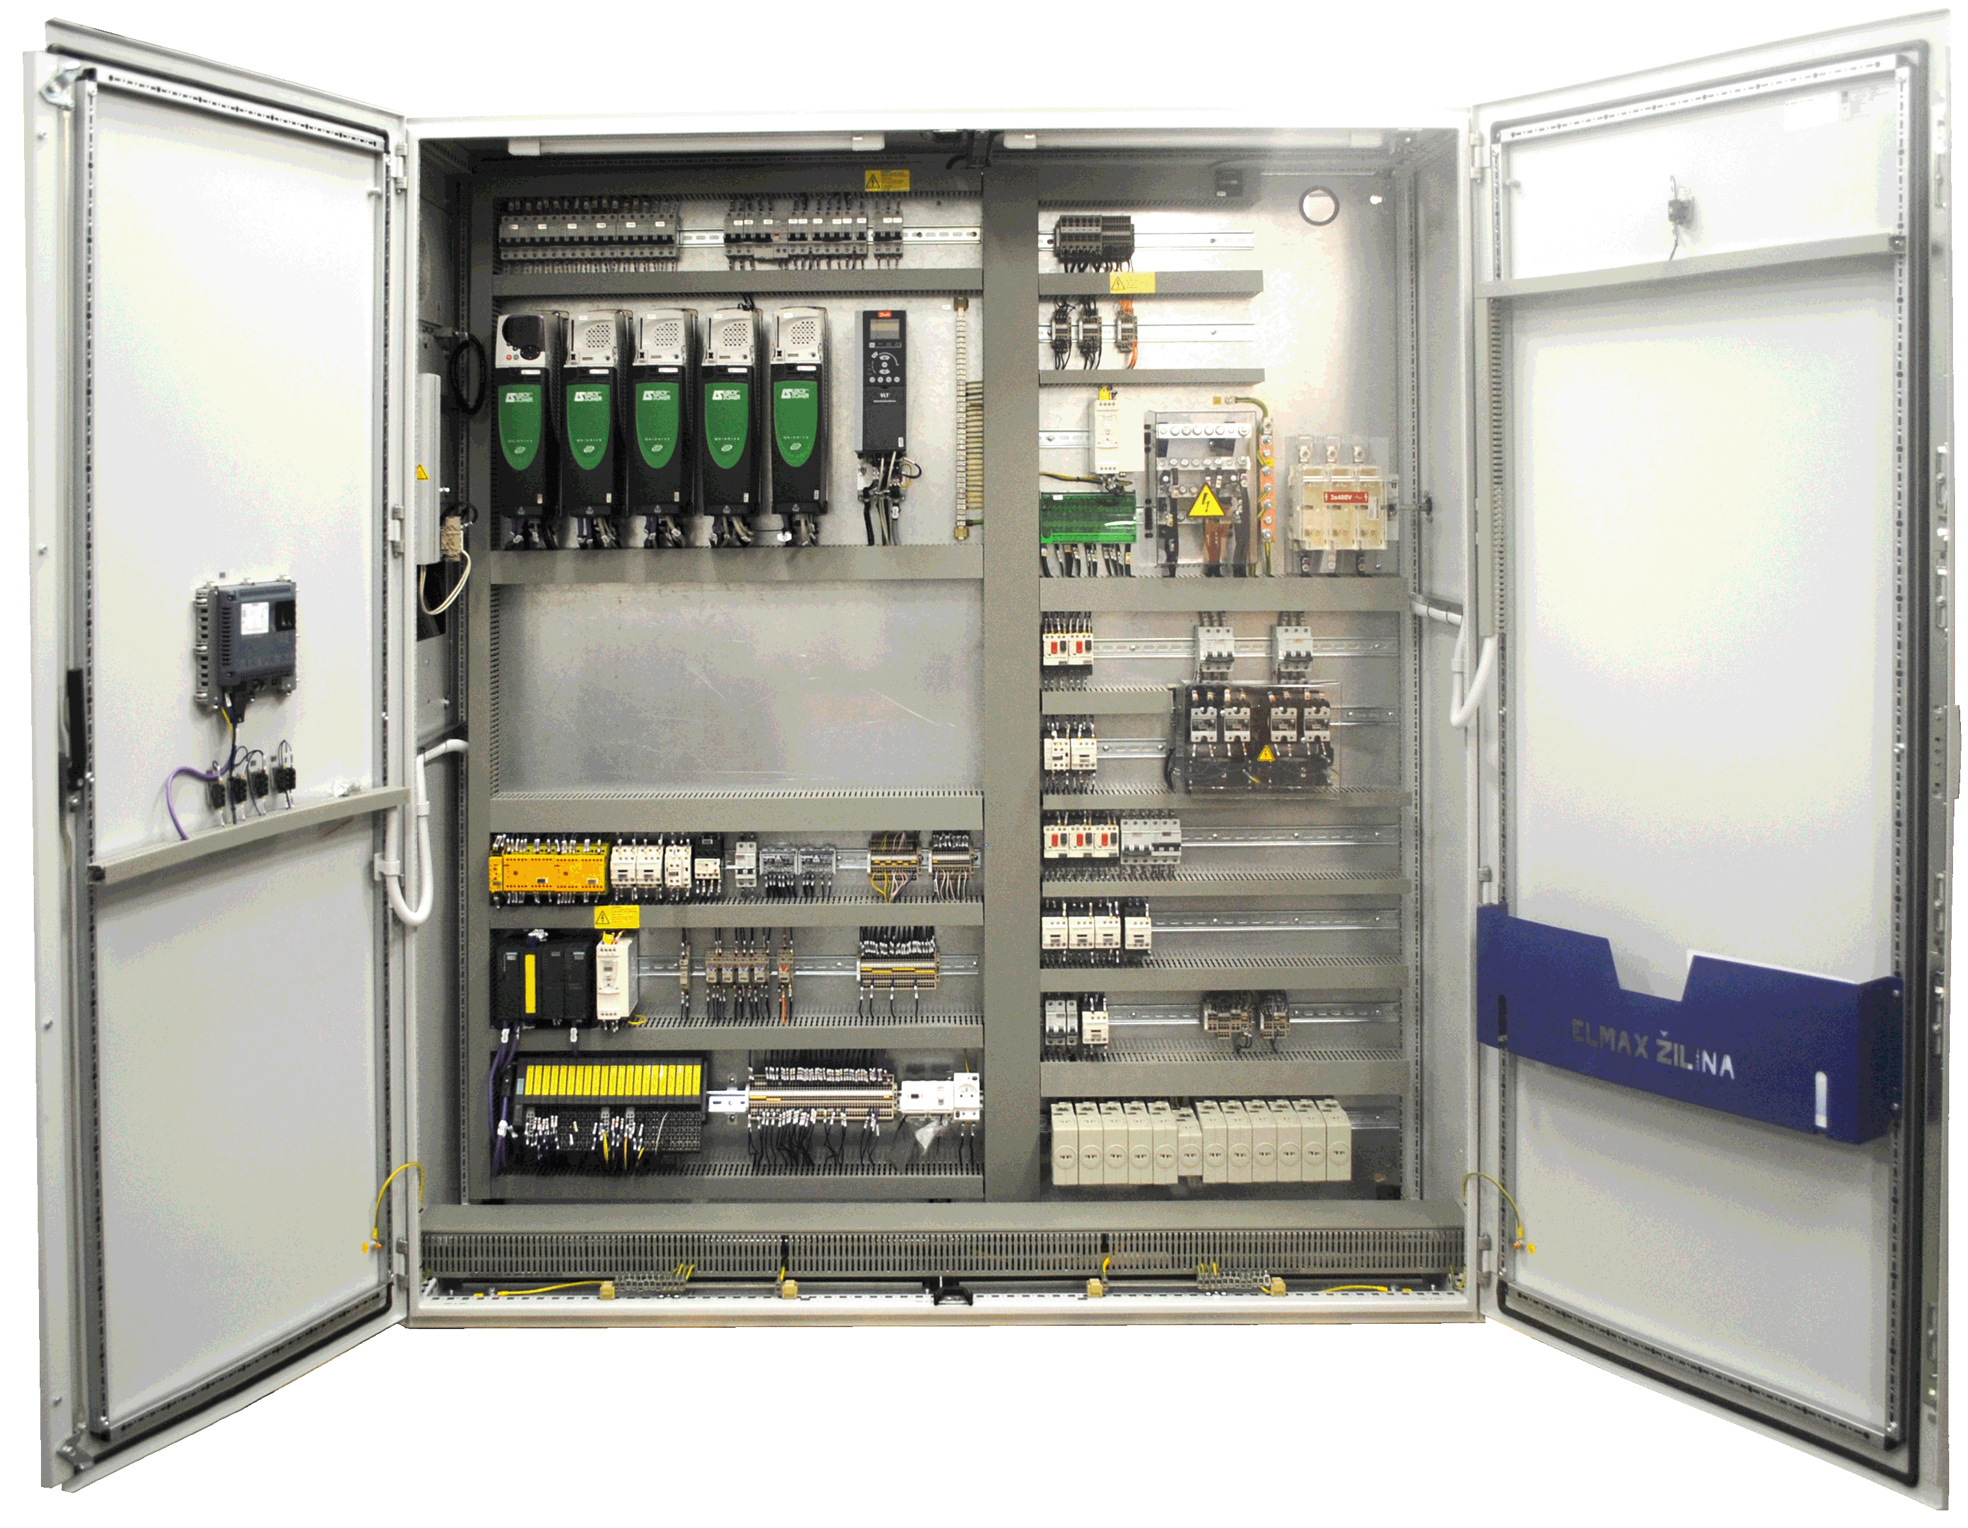
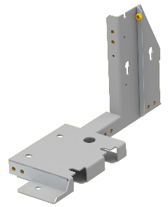
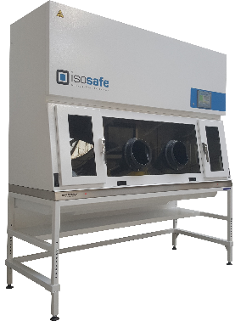
production program
Electrical production
Sheet metal processing
Laminar flow boxes and extraction devices

Slide 4
24 years on the market and still growing
1993
10.8.1993 – found company ELMAX
only sales activities

Slide 5
24 years on the market and still growing
2001
31.10.2001 – transformation to a joint stock company ELMAX ZILINA, Inc.

Slide 6
24 years on the market and still growing
2002
acquisition – Elektrostav, a.s.
outsourcing - electrical maintenance for the company Biotika, a.s. Slovenska Lupca

Slide 7
24 years on the market and still growing
2003
acquisition – Emtech, s.r.o.
expansion of the portfolio – automation
innovations - CNC punching machine

Slide 8
24 years on the market and still growing
2005
innovations - CNC bending machine

Slide 9
24 years on the market and still growing
2006
innovations – industrial paint finishing line

Slide 10
24 years on the market and still growing
2007
implementation ISO 9001:2008
certified QMS – Quality Management System

Slide 11
24 years on the market and still growing
2008
innovations - CNC laser cutting machine

Slide 12
24 years on the market and still growing
CNC stroj na nanášanie tesnenia
inovácie - CNC ohýbací stroj
Prvý slovenský výrobca rozvádzačov s kompletnou výrobnou technológiou.
Projekt bol realizovaný s podporou Európskej únie, cez operačný program Konkurencieschopnosť a hospodársky rast.
2010
innovations - CNC bending machine
CNC machine for application of sealant
The first Slovak producer distributors with a complete production technology.
The project has been funded with support from the European Union, through the Operational Programme Competitiveness and Economic Growth.

Slide 13
24 years on the market and still growing
2012
switchboards and switchgear cabinet met UL requirements for safety
export to the U.S. market
The only Slovak manufacturer of UL certified switchboards and control cabinets.

Slide 14
24 years on the market and still growing
2013
EN 1090 certification
Licence for manufacturing of steel structures

Slide 15
24 years on the market and still growing
2014
CNC punching machine TruPunch 5000
The project has been funded with support from the European Union, through the Operational Programme Competitiveness and Economic Growth.

Slide 16
24 years on the market and still growing
2014
building of the new warehousing spaces - 700 m²

Slide 17
24 years on the market and still growing
2015
acquisition – EKOKROK s.r.o.
company space extension to 4000 m²

Slide 18
24 years on the market and still growing
2017
innovations - CNC bending machine ToolCell

Slide 19
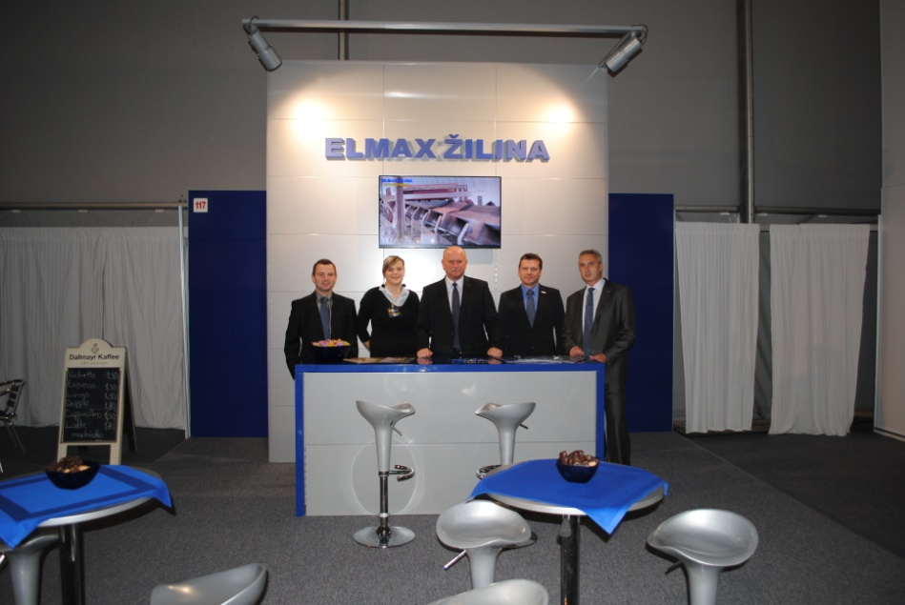
participation in exhibitions
2002 Coneco Bratislava
2008 Energetika Zagreb
2009 Elektro Moscow
2011 Elektro Moscow
2011 Elosys Trencin
2012 Elosys Trencin
2013 Elektro Moscow
2013 Amper Brno
2014 Amper Brno
2014 Hannover Messe Hannover
2015 Elektro Moscow
2015 Hannover Messe Hannover
2016 Hannover Messe Hannover
2017 Elosys Nitra
2017 FIHAV CUBA

Slide 20
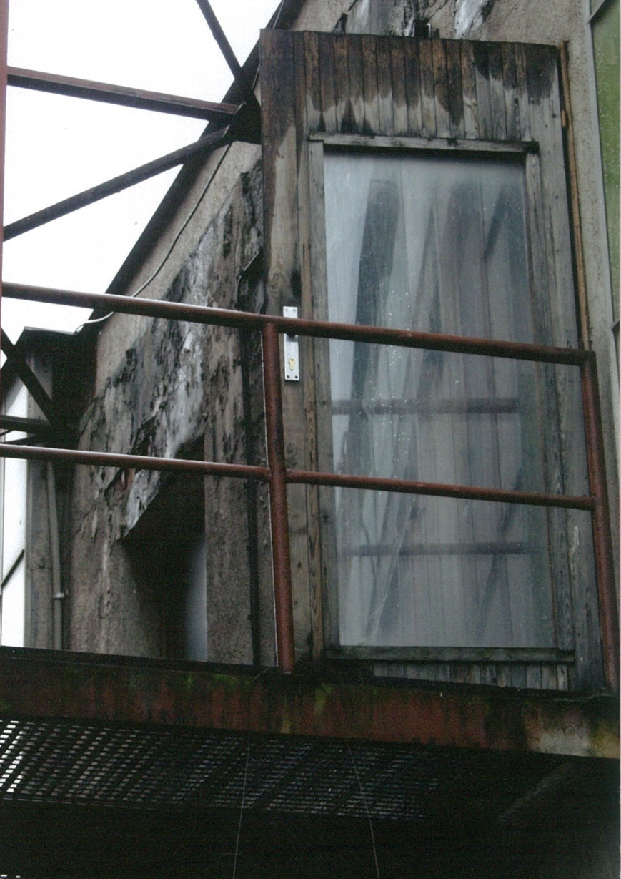
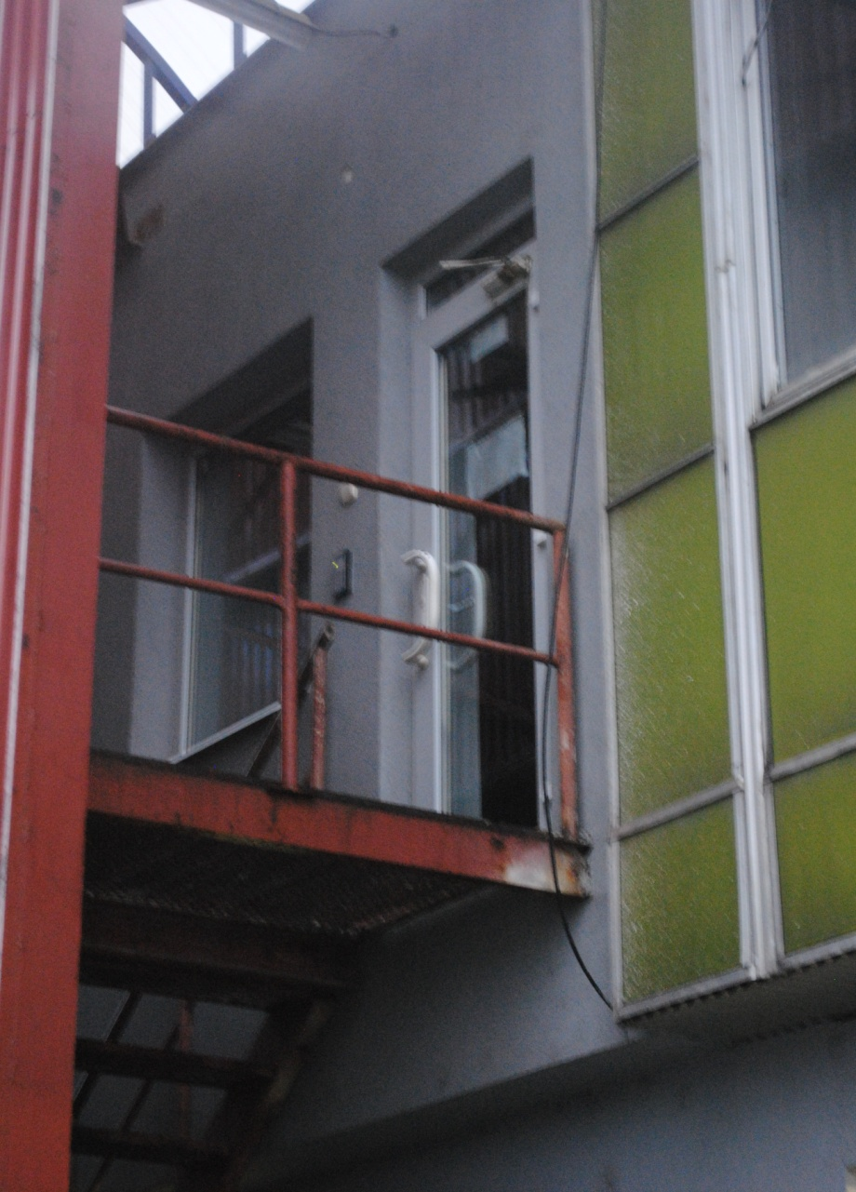
history vs. today

Slide 21
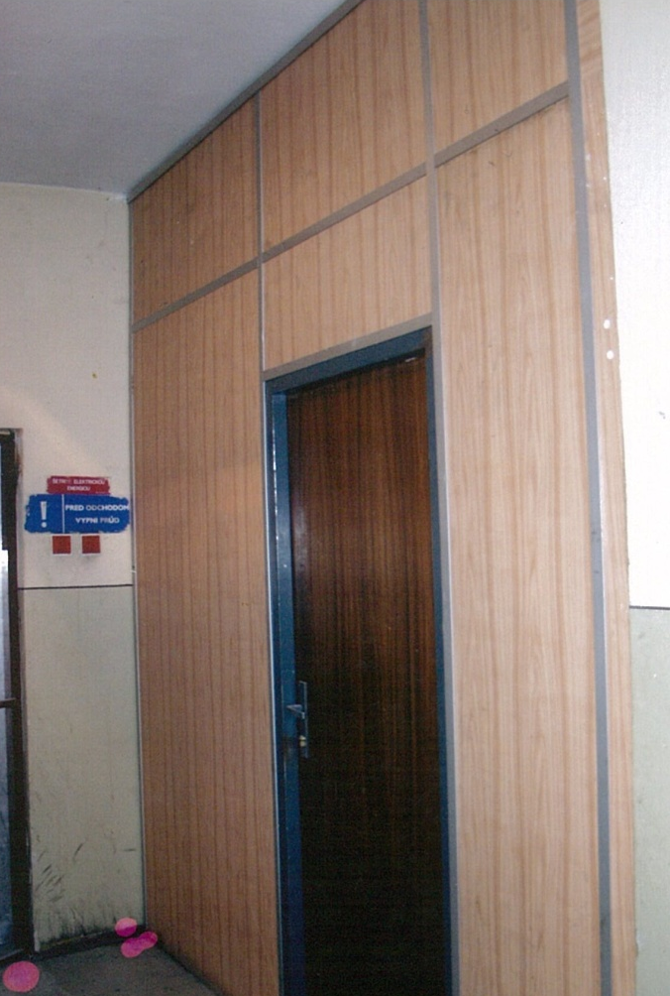
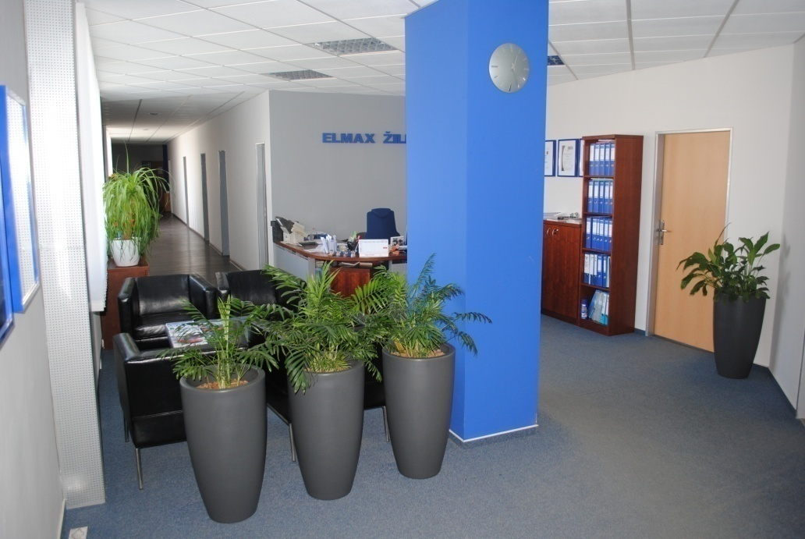
history vs. today

Slide 22
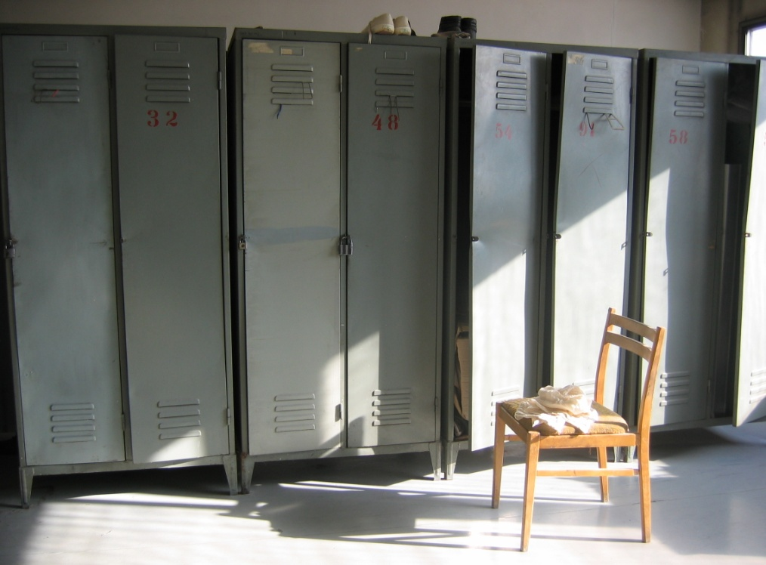
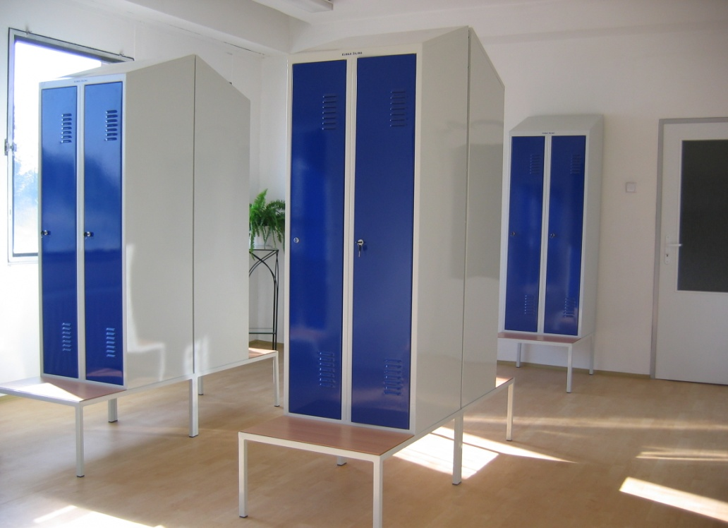
history vs. today

Slide 23
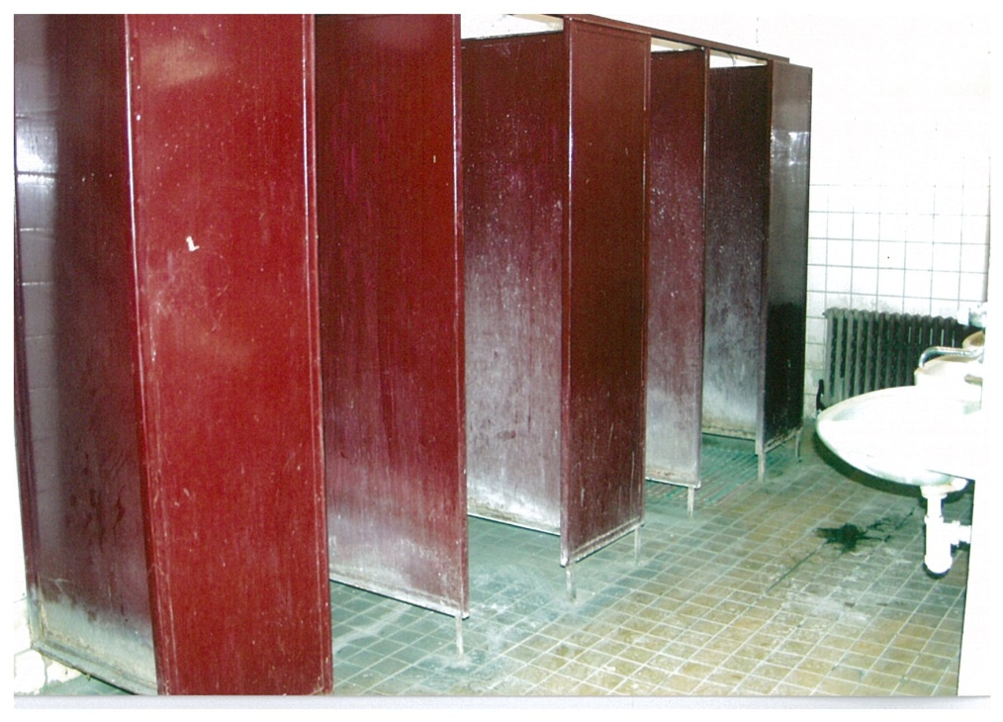
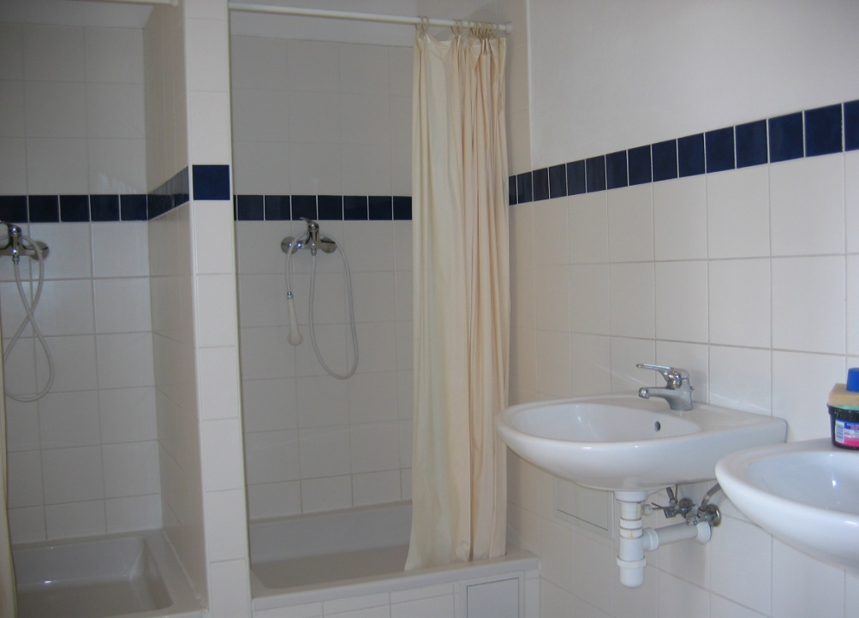
history vs. today

Slide 24
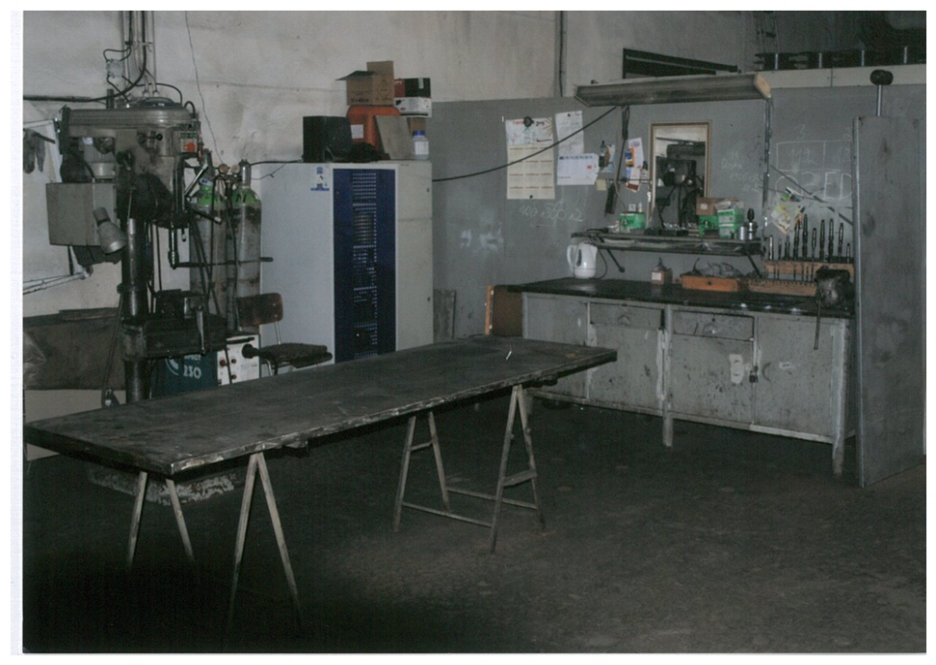
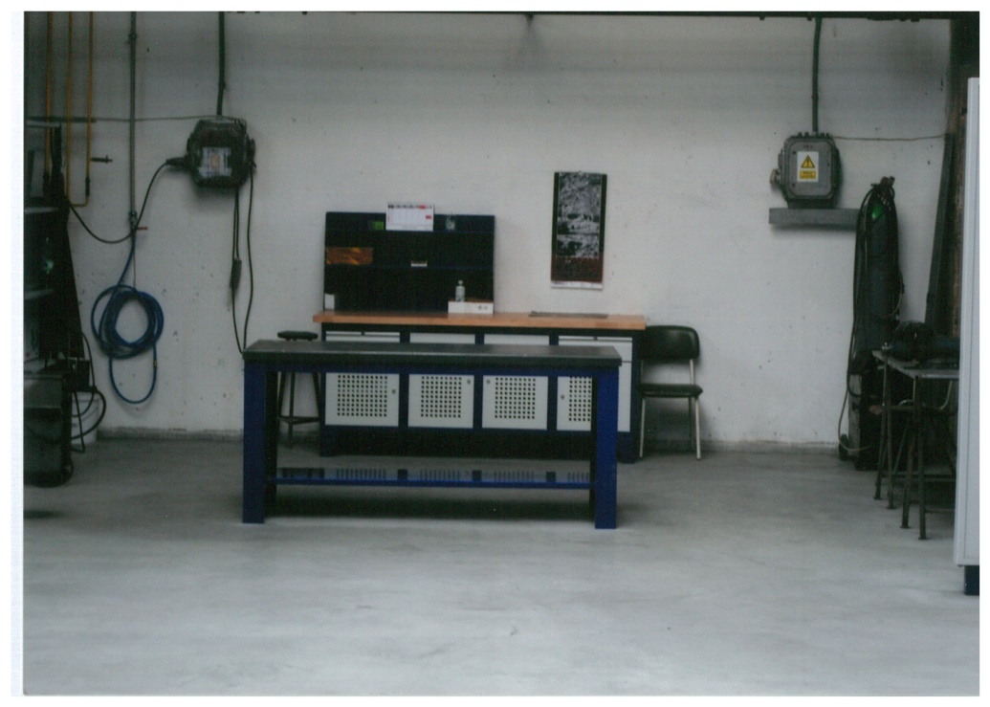
history vs. today

Slide 25
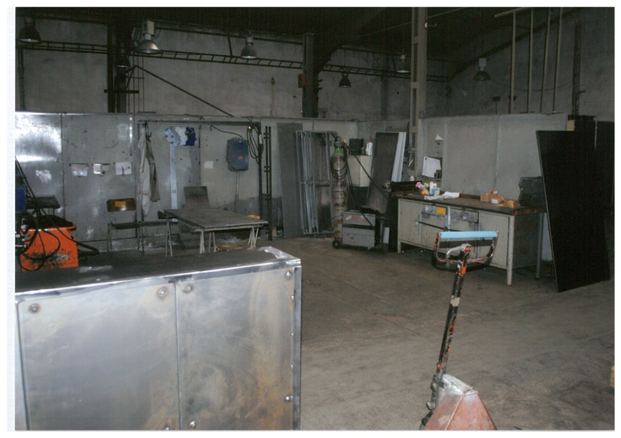
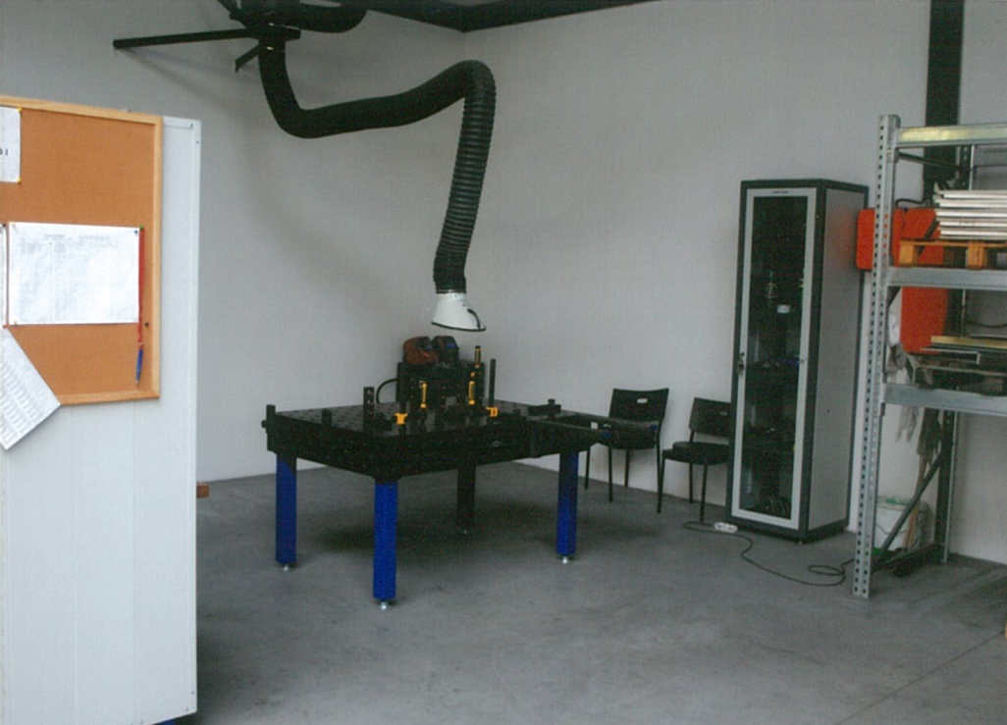
history vs. today

Slide 26
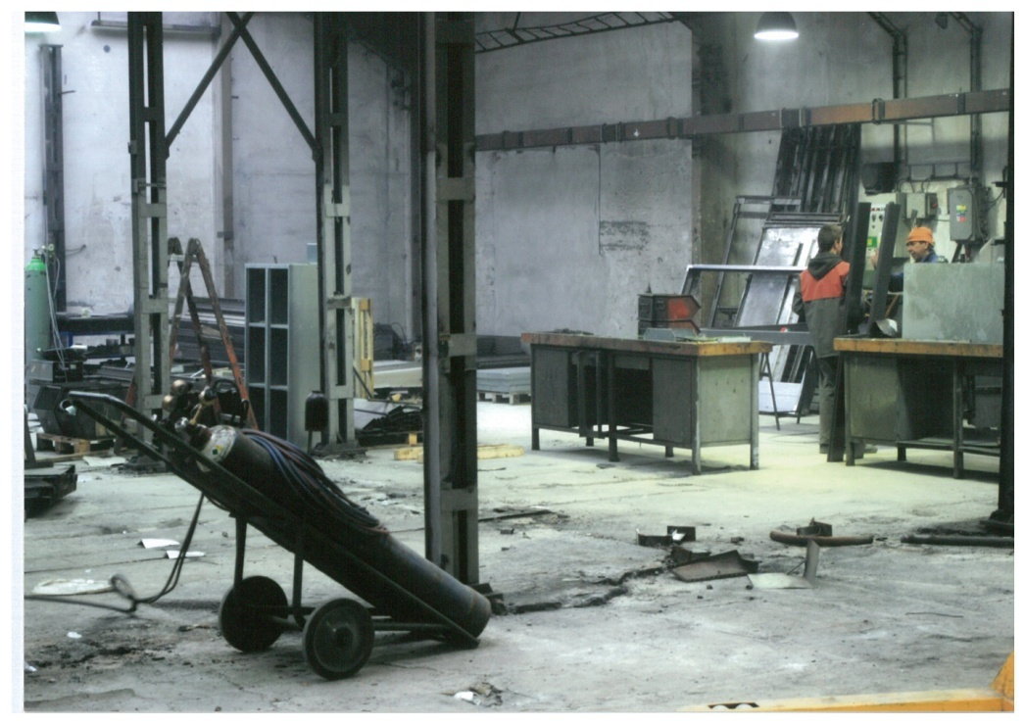
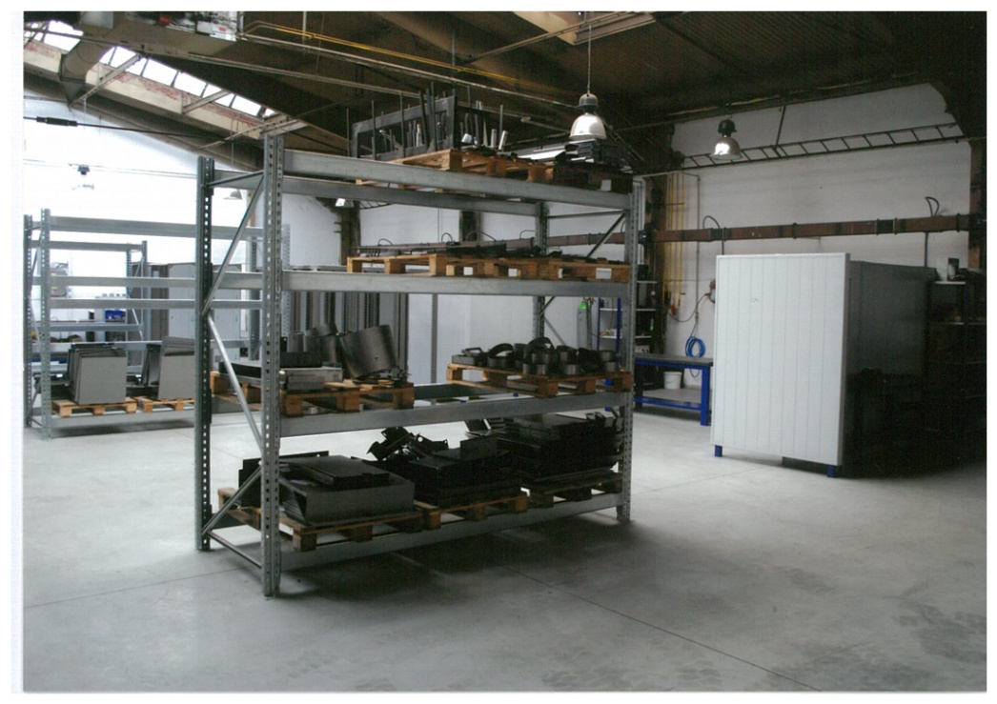
history vs. today

Slide 27
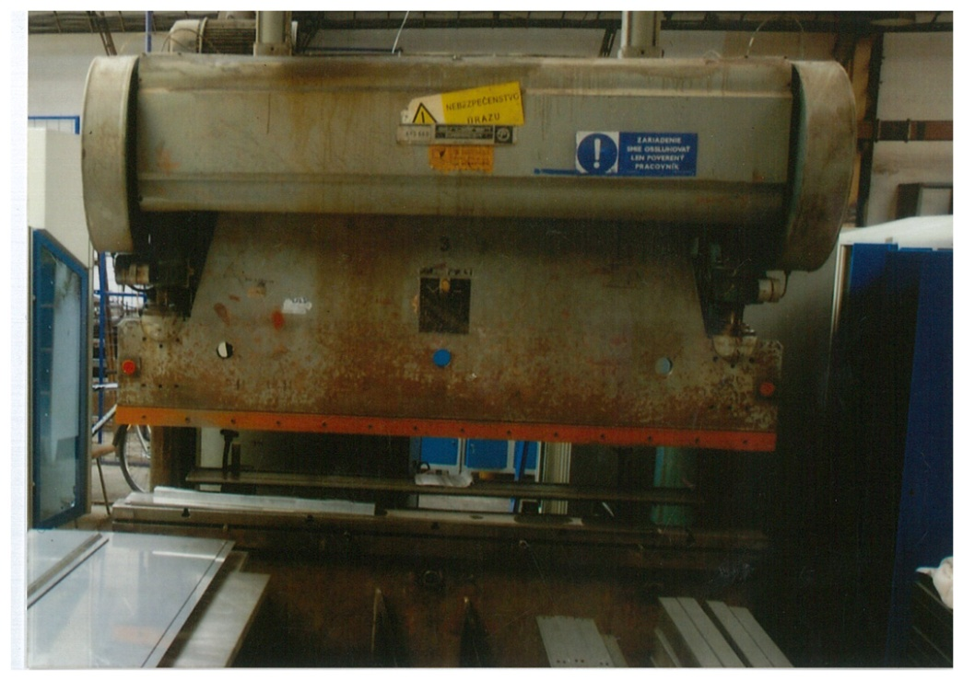
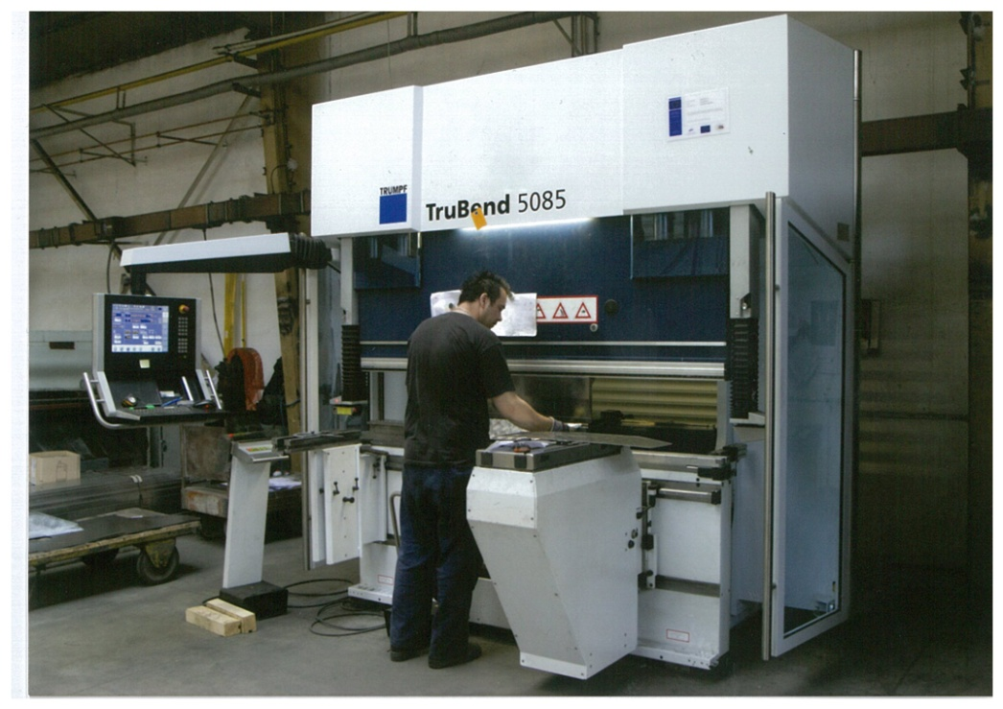
history vs. today

Slide 28
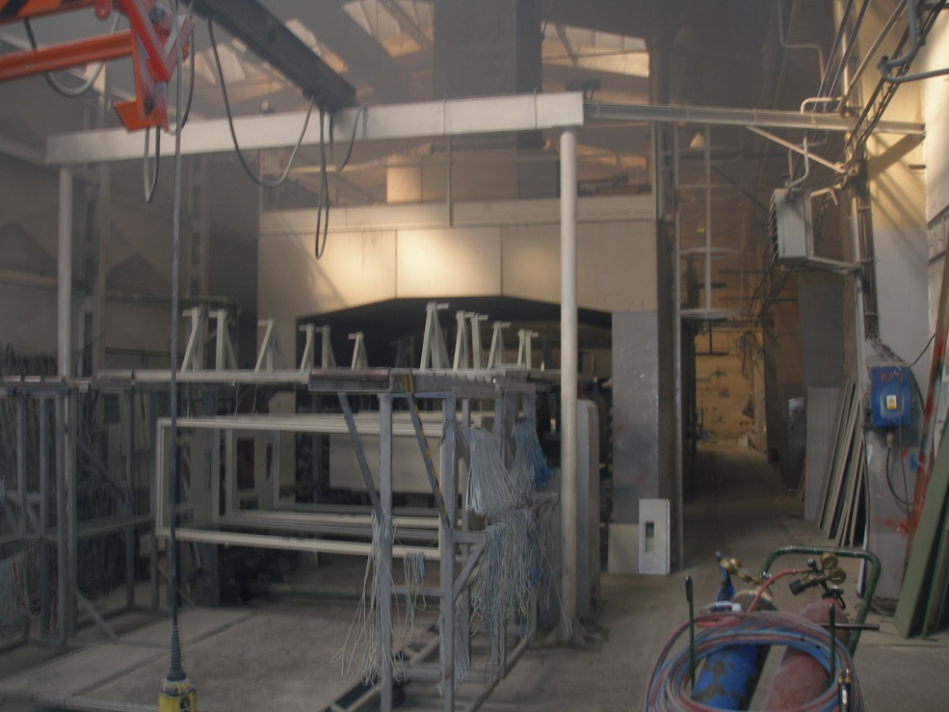
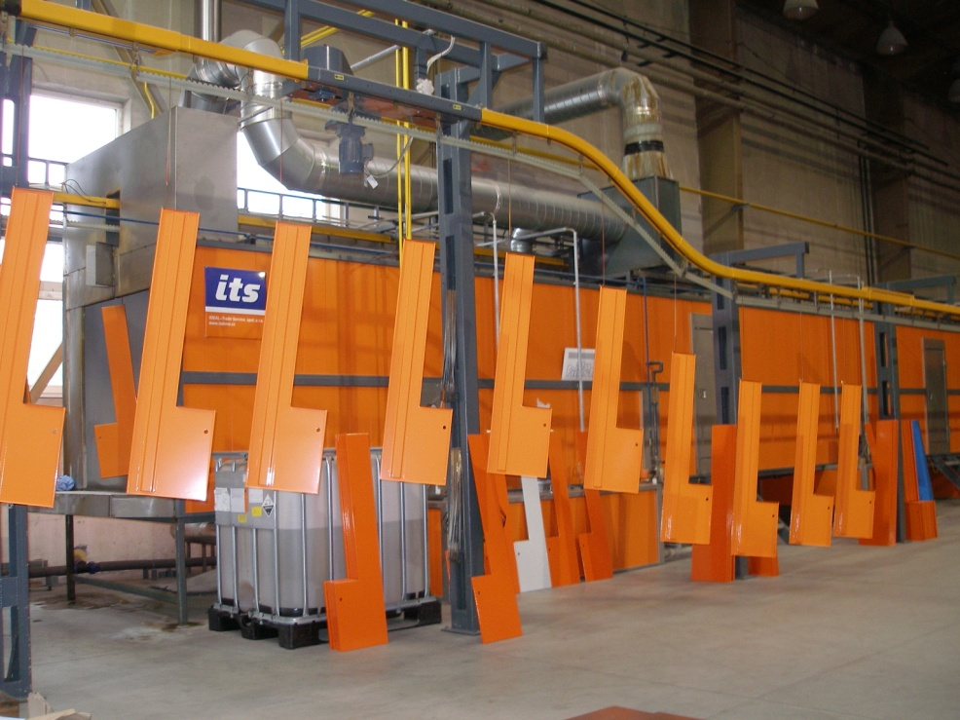
history vs. today

Slide 29
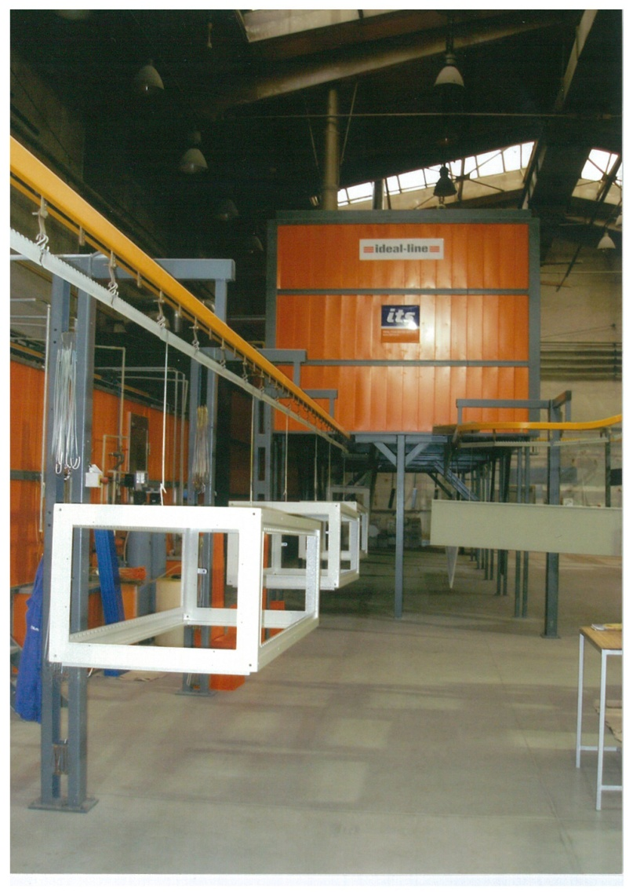
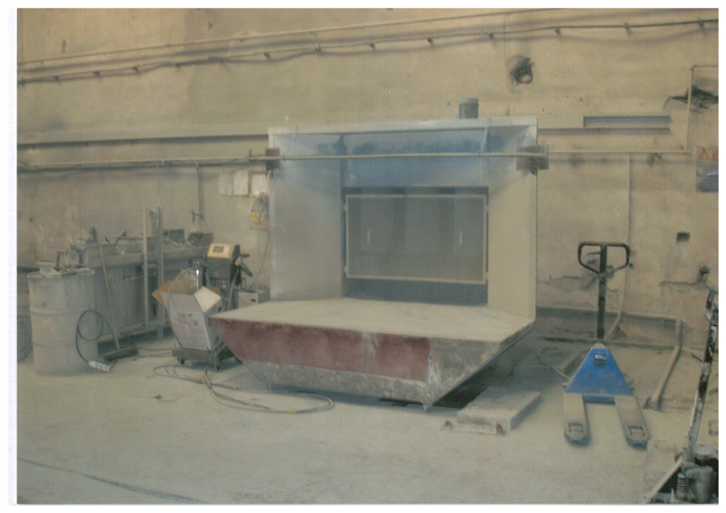
history vs. today

Slide 30
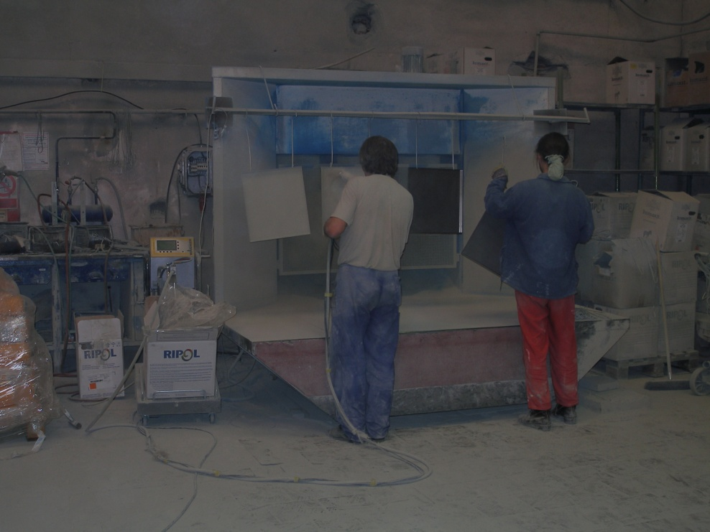
history vs. today

Slide 31
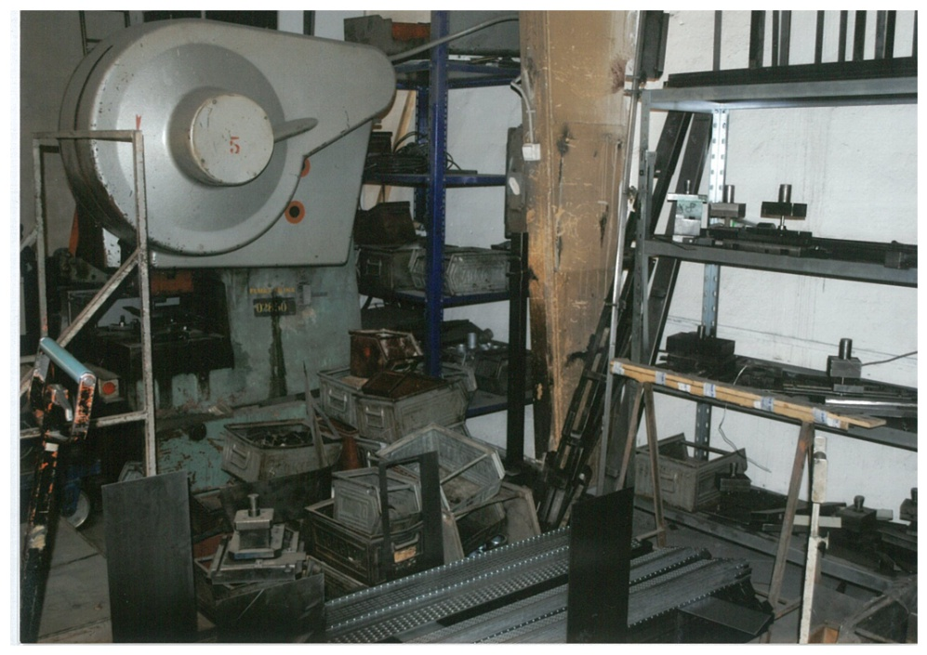
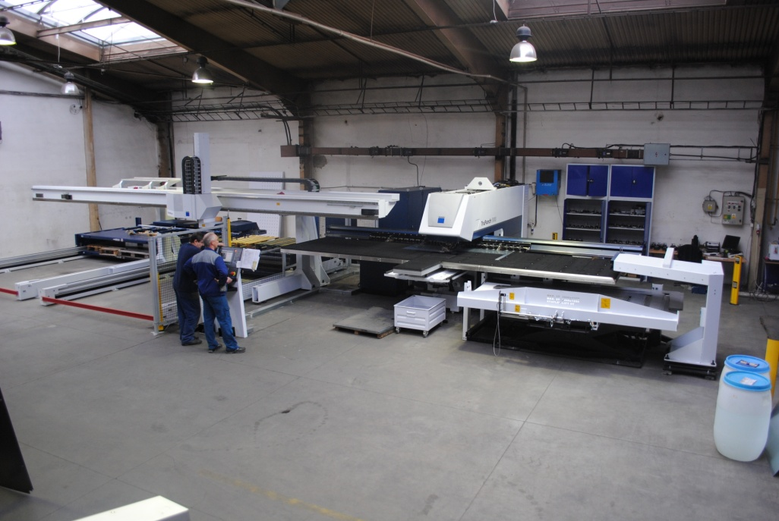
history vs. today

Slide 32
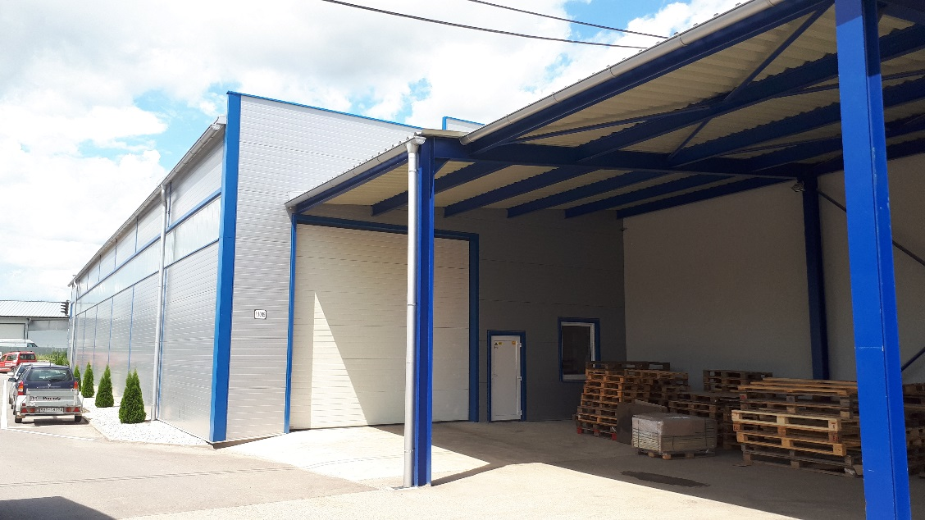
history vs. today

Slide 33
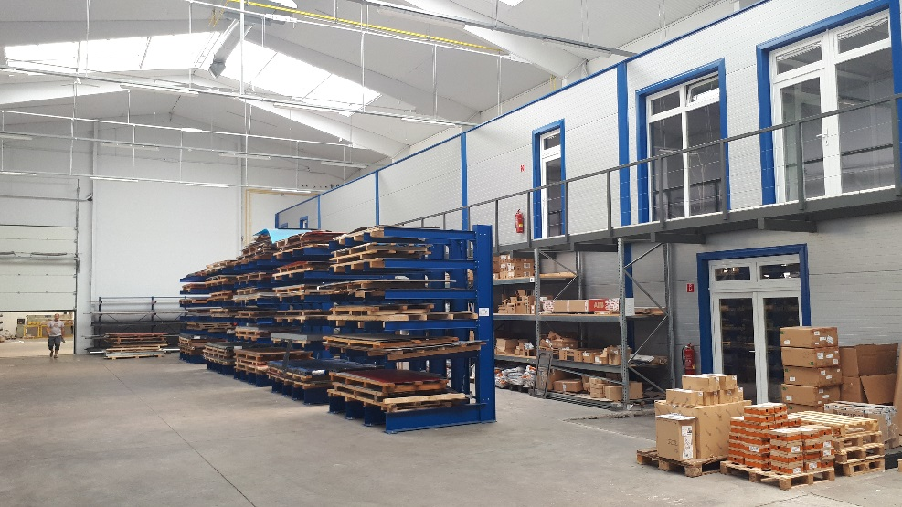
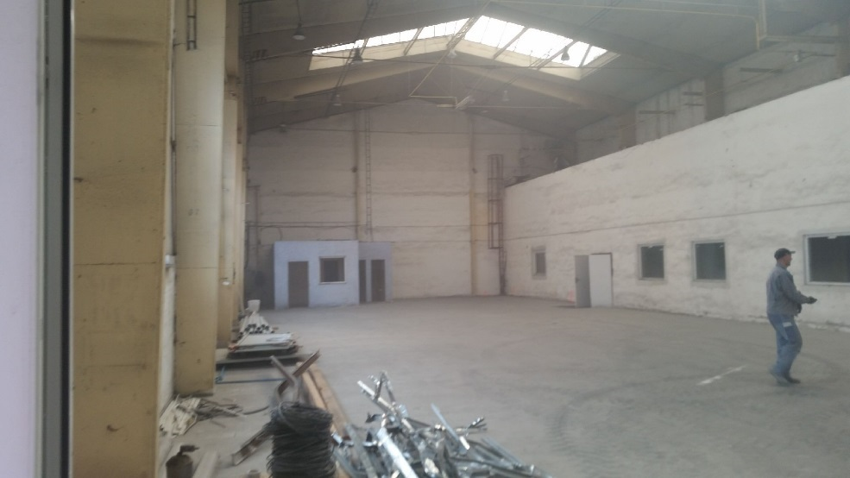
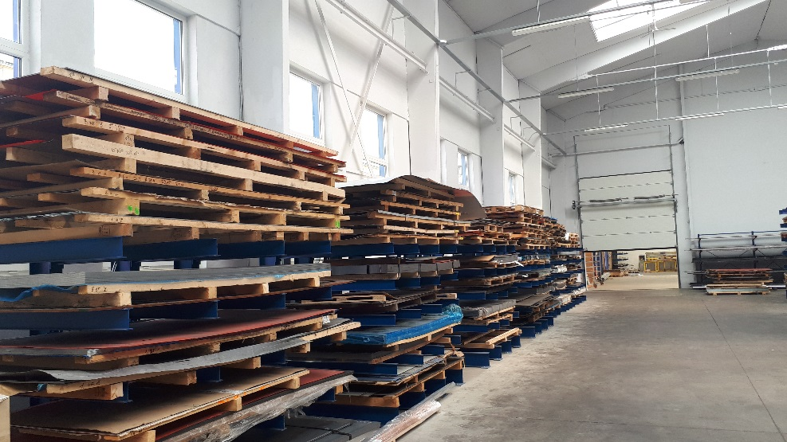
history vs. today

Slide 34
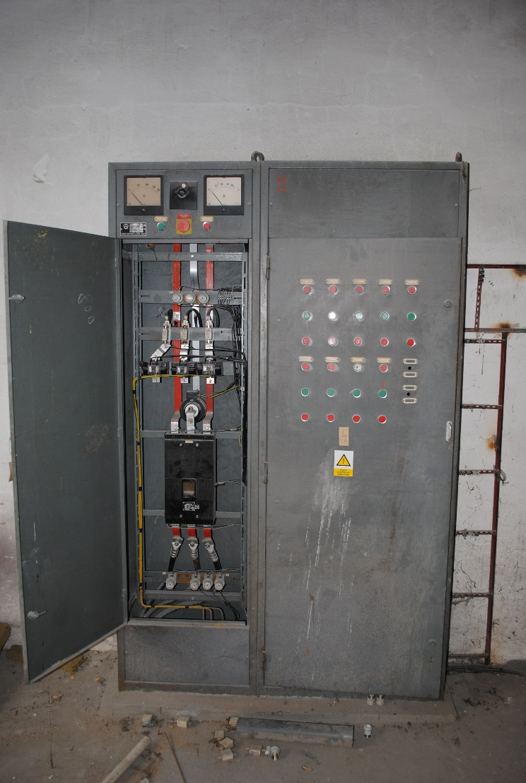
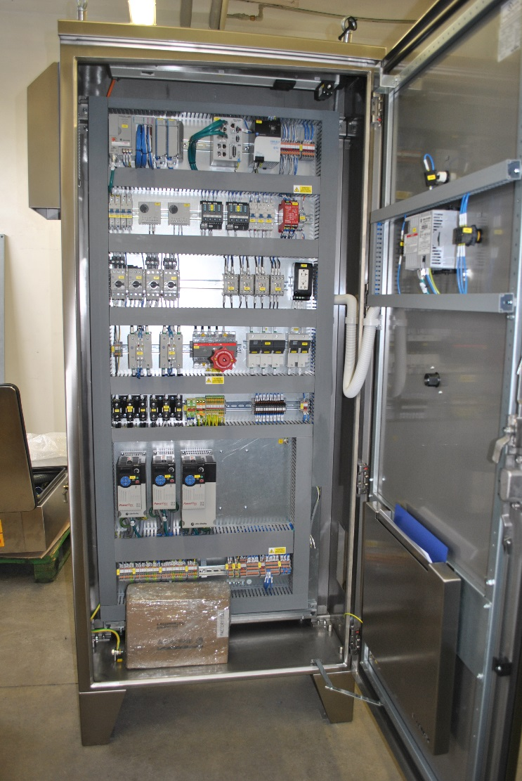
history vs. today

Slide 35
annual turnover

Slide 36
employees

Slide 37
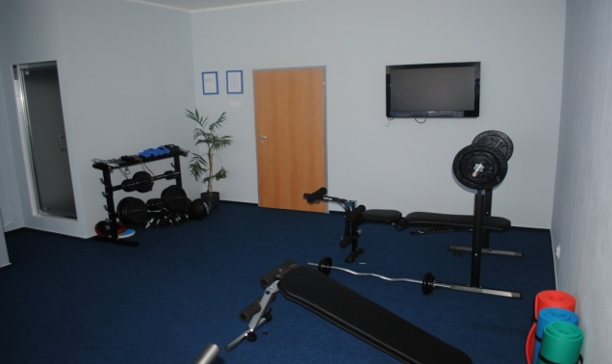
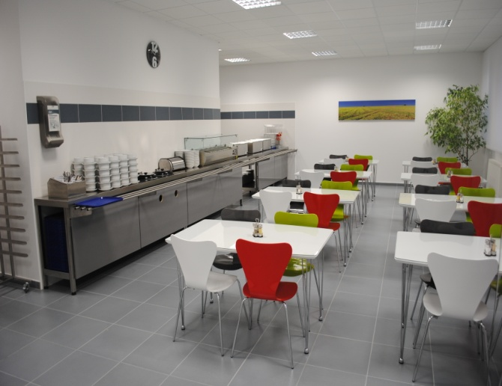
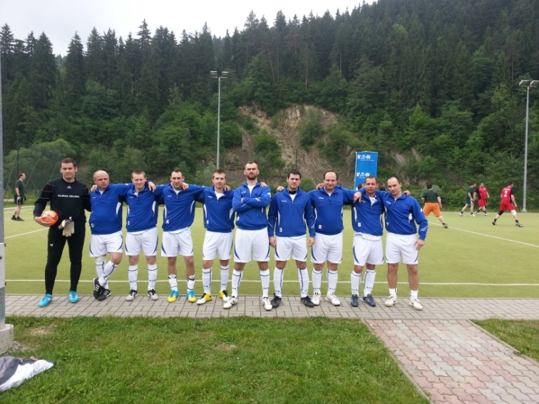
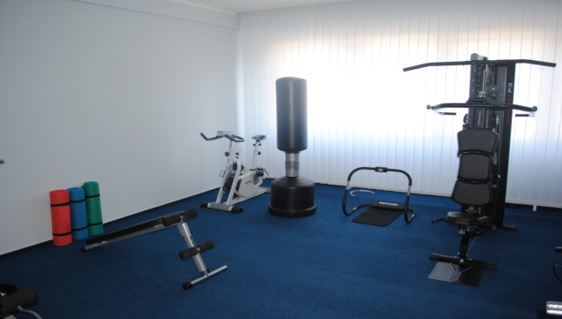
employee benefits
Social programs
and
initiatives
Corporate cattering
Corporate skiing
Fitness center
Teambuildings
Technical education
Football tournament
Soft skills trainings

Slide 38
vision
“Our vision is to be active company on Slovak market, characterized by long term profit and high social credit. In all segments we apply following politics:
- customer determines our actions
business success is our surety
excellent leadership achieve superior results
stable business relationships are our basis
performance growth – our perspective
we work with social responsibility on mind.“
Jozef Štalmach, Chairman and CEO, ELMAX ZILINA, a.s.

Slide 39
our success - quality
Certified Quality Management System ISO 9001:2008
Industrial certificates
UL certified partner
ISO EN 1090 certified partner
Electrical equipment CE certifications

Slide 40
customer success
Trust/ Fairness/ Integrity
Own Responsibility
Open
Communication
Feedback
Continuous Improvement
Innovations
Quality Team
Contribution to the profit
Enhancement of the market position
Collaboration/
Teamwork
Drive Change
Fun

Slide 41
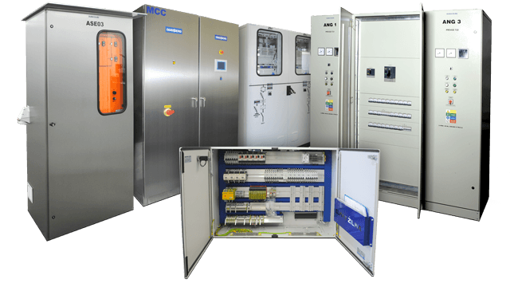
electrical production
Switchboards
Control panels
Low voltage aplications (up to 1000V / 2500A)
Standard production
Custom production
Renowned supliers components used
(Siemens, Schneider, Eaton...)

Slide 42
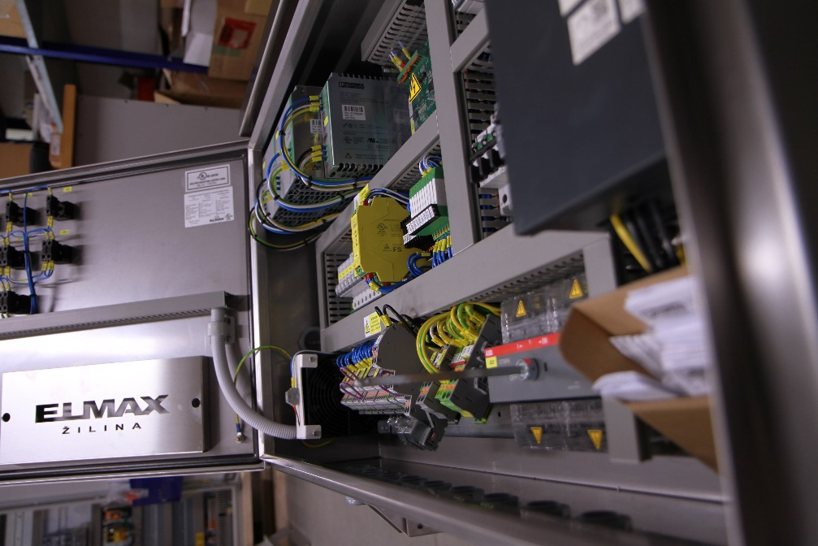
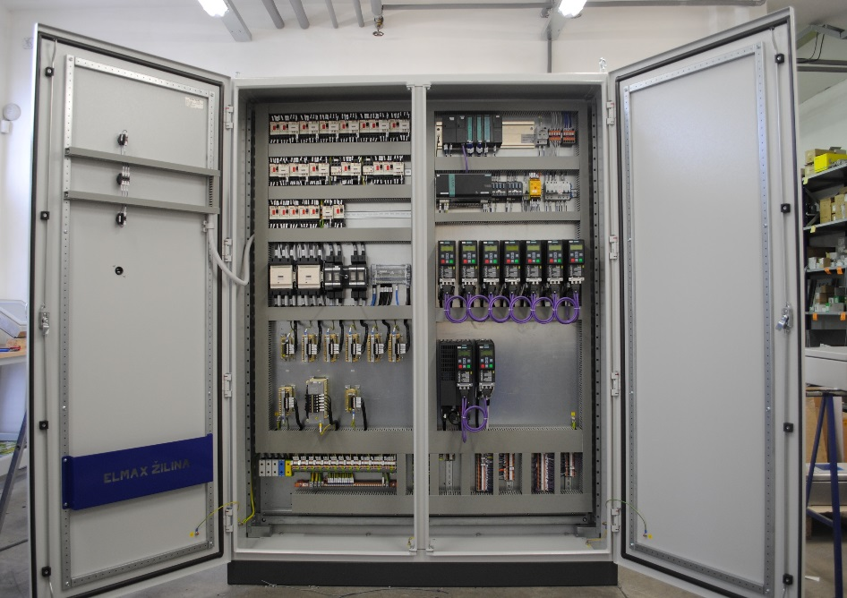
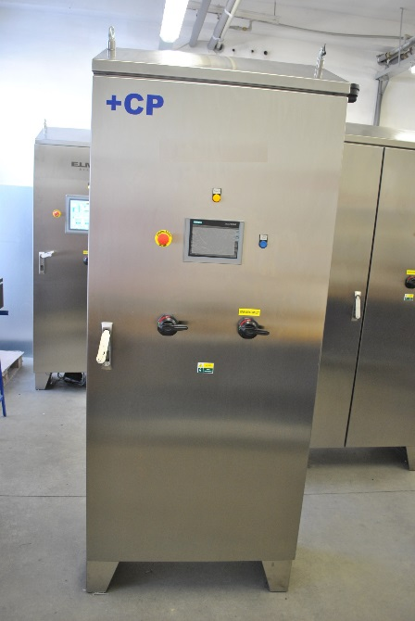
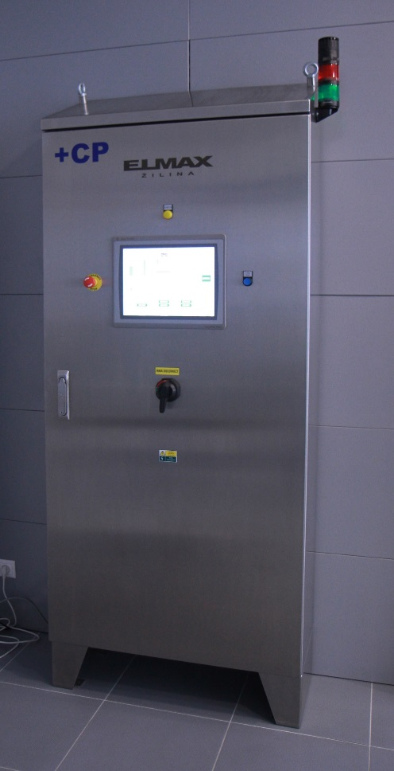
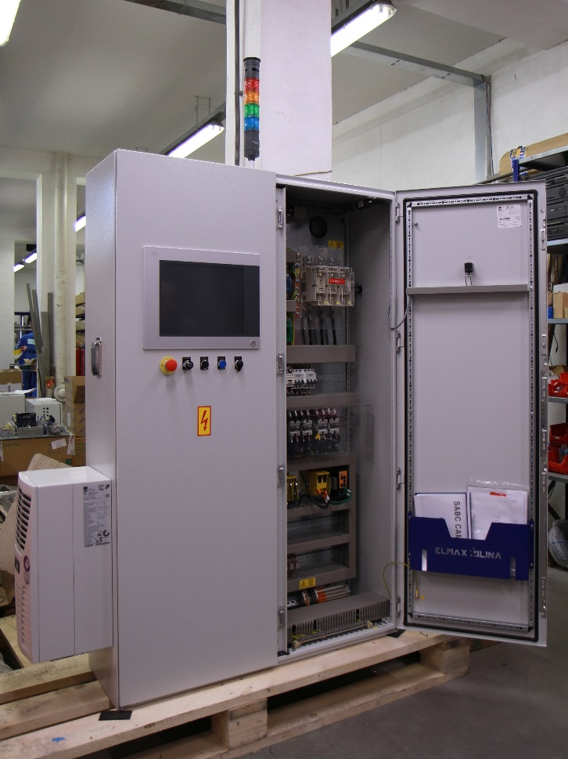
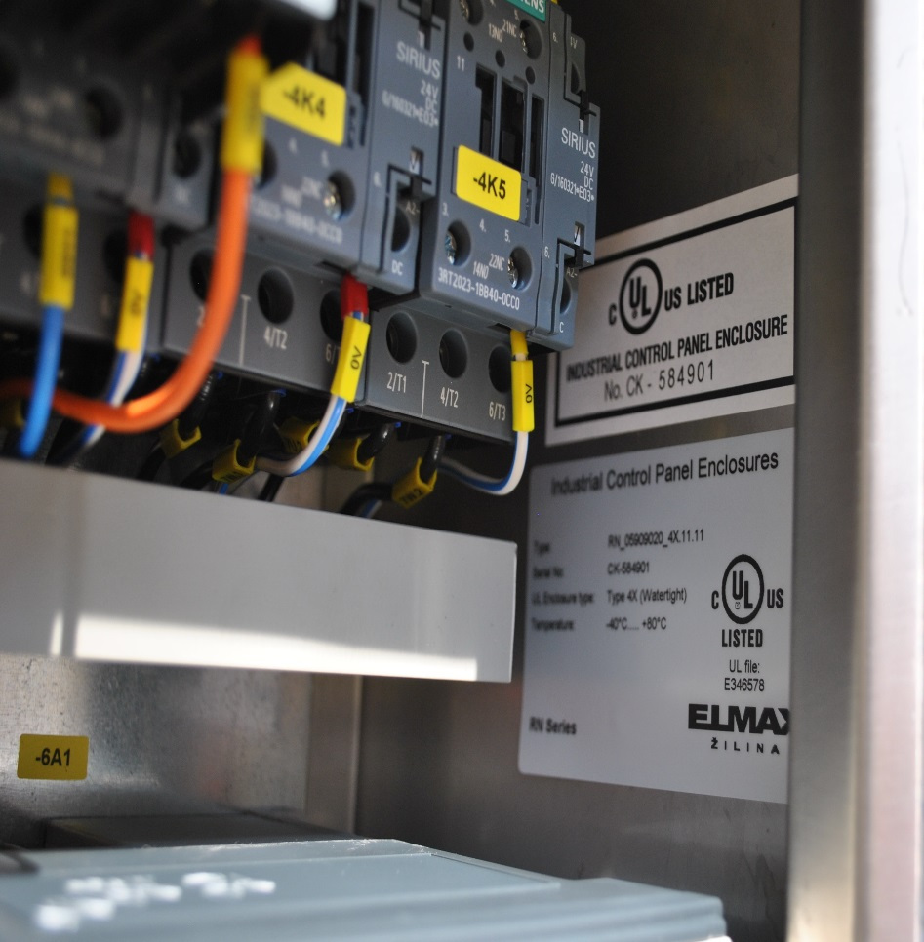

Slide 43
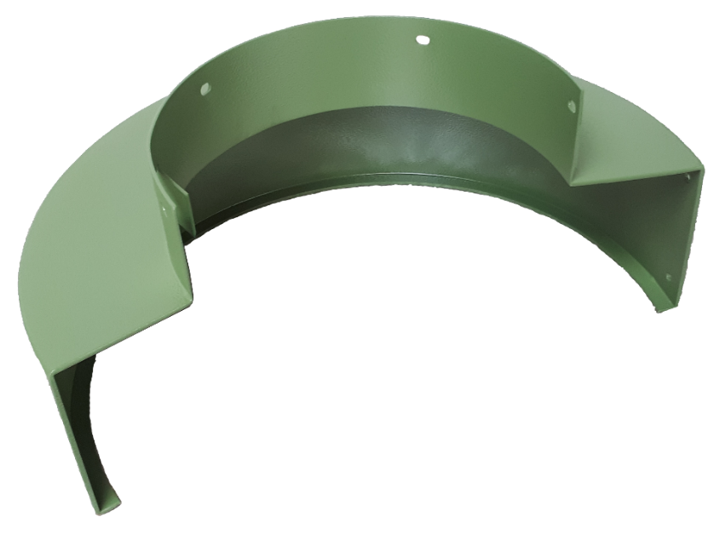
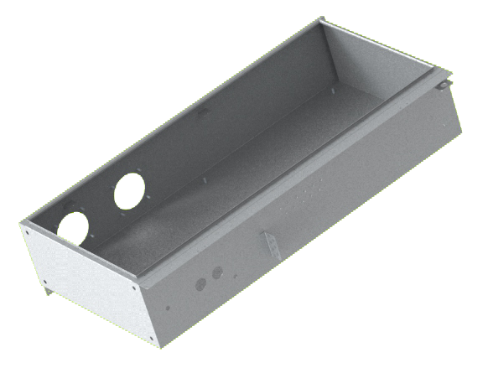
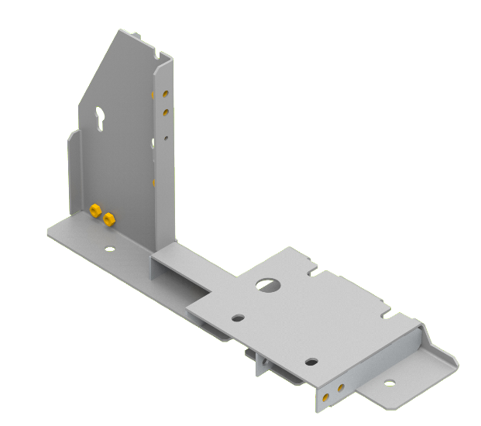
sheet metal processing
Modern processing technologies
Software design tools
CNC machines
Precise, fast, high quality
Standard and custom production

Slide 44
laminar flow boxes and extraction devices
For health service, food industry, pharmaceuticals and chemical industry
Class I - laminar flow boxes with vertical or horizontal air flow
Class II laminar flow boxes (BIOHAZARD) with vertical air flow and bottom air exhaustion
Safety biological boxes of Class III– biological insulators (GLOVEBOXES)
Ceiling modules ensuring clean spaces
Laboratory fume hoods with upper and bottom extraction

Slide 45
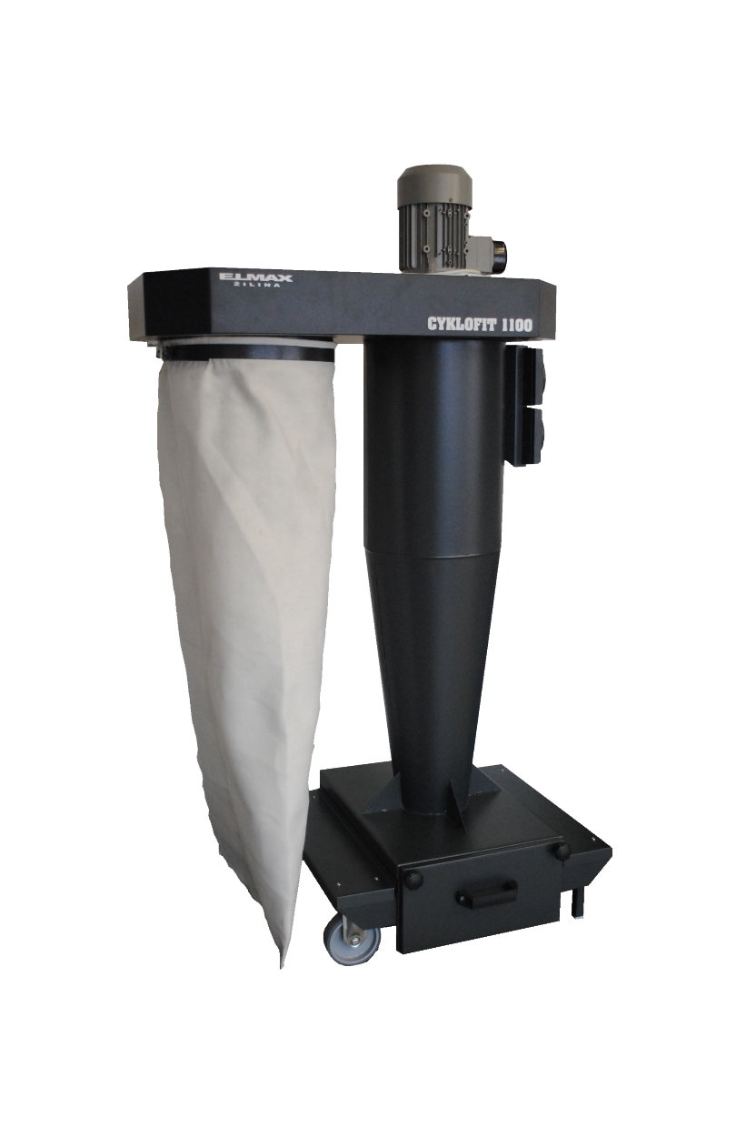
laminar flow boxes and exhaustion devices
For industrial operations
Extraction systems with electrostatic filtration
Extraction systems with mechanical filtration
Welding tables with fume extraction and filter
Extraction ventilators

Slide 46
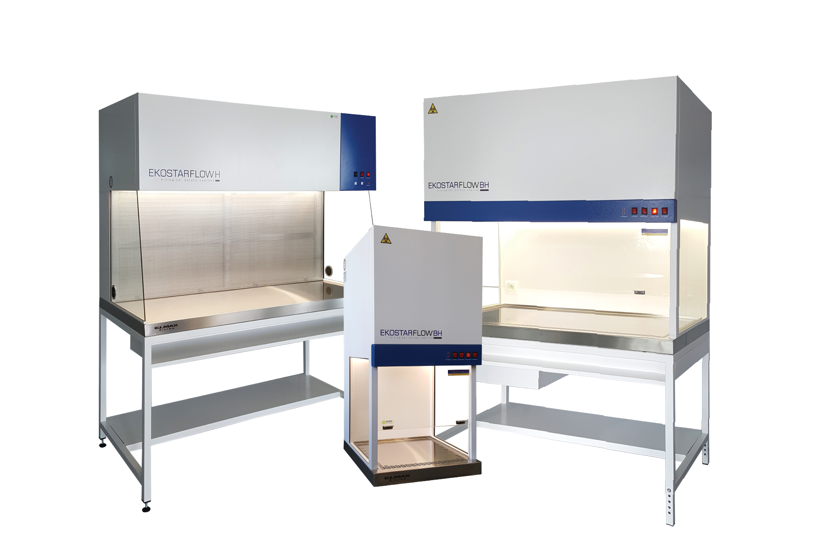
laminar flow boxes and extraction devices

Slide 47
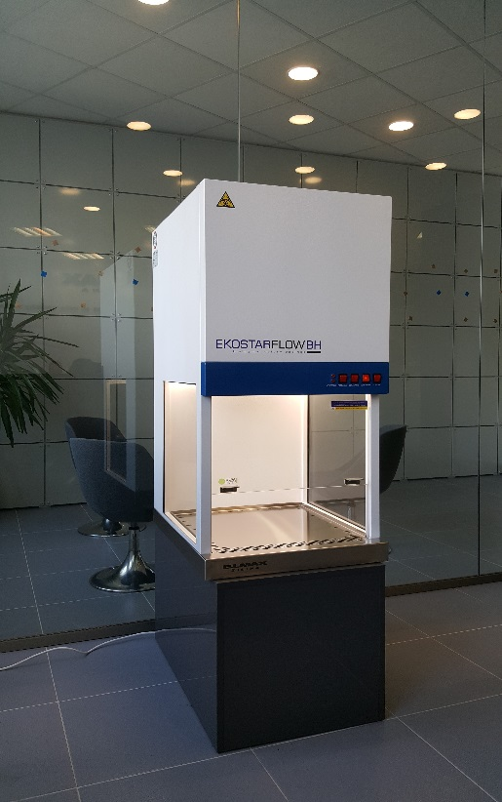

Slide 48
technological capacities (possibilities)
Shearing
Punching
Laser cutting
Bending
Drilling
Welding
Powder coating
Foam gasket dosing
Assembling

Slide 49
punching
TruPunch 5000
Up to 2.5 mm carbon steel
Up to 2.5 mm stainless steel
max. 3000x1500 mm
Accuracy +- 0.1 mm
Special shapes

Slide 50
laser cutting
TruLaser 3030
Up to 20 mm carbon steel
Up to 12 mm stainless steel
Up to 8 mm aluminium
max. 3000x1500 mm
Accuracy +- 0.1 mm
Engraving

Slide 51
bending
TrumaBend V850S
pressing force 85 tonnes
max. length 2 700mm/max. thickness 2mm
max. thickness 10mm/max. length 500mm
Accuracy +- 0.1mm
TruBend 5085
pressing force 85 tonnes
max. length 2 200mm/max. thickness 2mm
max. thickness 10mm/max. length 500mm
Accuracy +- 0.1mm

Slide 52
bending
ToolCell
pressing force 135 tonnes
max. length 3 000mm/max. thickness 6mm
max. thickness 10mm/max. length 500mm
Accuracy +- 0.1mm

Slide 53
welding
Gas metal arc welding - MIG, MAG
Steel up to 20mm, CO₂ gas
Tungsten inert gas welding - TIG
Stainless steel up to 5mm
Innert shielding gas - argon

Slide 54
powder coating
IDEAL LINE
great corrosion protection
max. size 2500x1000x1200 mm
different surface finish (shiny, matt, structured, smooth)
different RAL colors

Slide 55
foam gasket dosing
DM302
Max size 2100 x 1200mm
Gasket width 6-20mm
Hardness 56-58 Shore
Better protection against dust, water...

Slide 56
key suppliers

Slide 57
Time for your questions

Slide 58
Thank you for your attention

